Slide 1
Compiled 3D Fiber Segmentation Slides
Keshav Shivam

Slide 2
CT-FIRE Algorithm
“The approach of CT-FIRE combines the advantages of the fast discrete curvelet transform for denoising images, enhancement of the fiber edge features, and the fiber extraction (FIRE) algorithm for extracting individual fibers.” - Andrew et al.

Slide 3
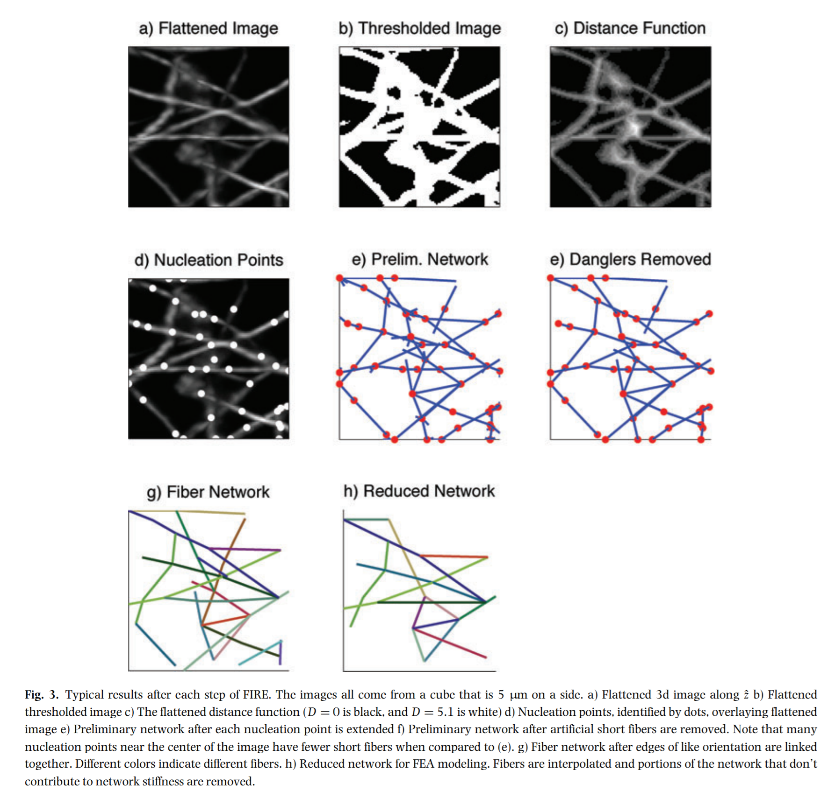
Flatten z-stacks along the axis perpendicular to focal plane.
Binary threshold on the image, into foreground vs background. Use relative intensity of pixels
Determine the minimum distance of each foreground pixel to the background. Apply a Gaussian filter.
Select nucleation points in the image to be the pixels with the maximum distance values.
Find the local maximum points (LMPs) of each nucleation points in a similar fashion. Continue to build the network until no more LMPs are found.
Remove short dangling fibers.

Slide 4
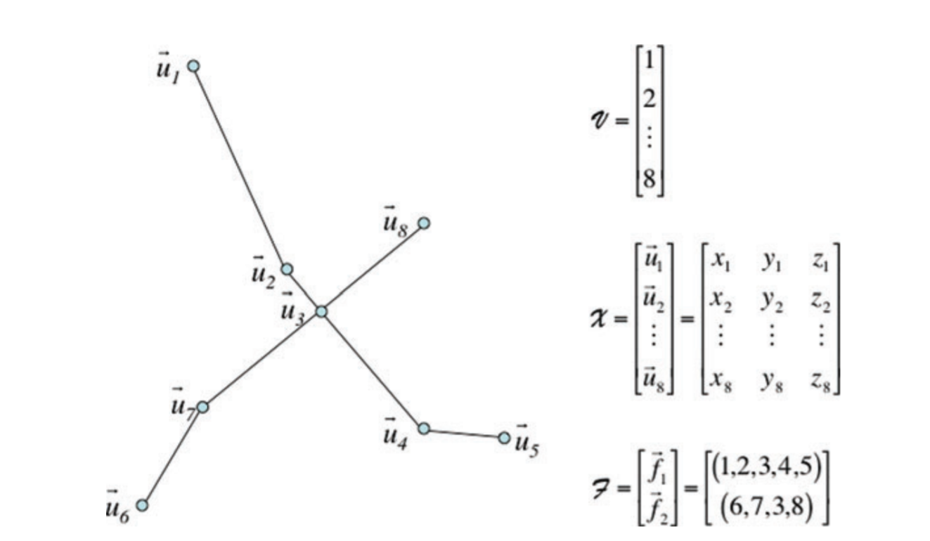
Network N = {V, X, F}.
V is a list of n vertices
X is a set of coordinates describing the position of each vertex
F the set of fibers, which are made of vertices.
V = {1, 2, …n}
X = {$\overset{⃑}{u}$₁, $\overset{⃑}{u}$₂, …, $\overset{⃑}{u}$_{n}} where $\overset{⃑}{u}$_{i} = (x_{i}, y_{i}, z_{i})
F = {$\overset{⃑}{f}$¹, $\overset{⃑}{f}$², …, $\overset{⃑}{f}$^{n}} where $\overset{⃑}{f}$^{k} = (v_{1k}, v_{2k}, …, v_{pk})

Slide 5
a) Flatten z-stacks along the axis perpendicular to focal plane.
Let image I($\overset{⃑}{u}$) define an image L x M x N be a mapping such that:
I($\overset{⃑}{u}$) : U → Z_{[0, 255]} , where U = {Z_{[0, L]} , Z_{[0, M]} , Z_{[0, N]}}
The flattened image J (x, y) = max_{z}{I(x, y, z)} and is in the direction $\hat{z}$, perpendicular to the focal plane.
Flattening takes the maximum intensity pixel value from the entire z stack at that x and y location. Alternative flattening methods to consider are sum slices, standard deviation, and mean intensity.
b) Binary threshold on the image, into foreground vs background. Use relative intensity of pixels
Apply a gaussian filter and binarize the image, so that pixel values are 1 if the pixel is a curvelet, else 0.
To binarize, all pixels that are brighter than a certain threshold are 1.
This threshold must be experimentally determined to maintain network topology.

Slide 6
c) Determine the minimum distance of each foreground pixel to the background. Apply a Gaussian filter.
The minimal distance from a fiber pixel to a background pixel is calculated. This distance function is then smoothed with a Gaussian filter and is represented by D($\overset{⃑}{u}$₁), with $\overset{⃑}{u}$₁$∈$ U.
d) Select nucleation points in the image to be the pixels with the maximum distance values.
$\overset{⃑}{B}(\overset{⃑}{u}$, r) = {$\overset{⃑}{v} ∈$ U | || $\overset{⃑}{u}$ - $\overset{⃑}{v}$ ||∞ ≤ floor(r) }
∂$\overset{⃑}{B}(\overset{⃑}{u}$, r) = {$\overset{⃑}{v} ∈$ U | || $\overset{⃑}{u}$ - $\overset{⃑}{v}$ ||∞ = floor(r) }
Let the nucleation points P be such that:
P = {$\overset{⃑}{u} ∈$ U | D($\overset{⃑}{u}$) ≥ max{θ_{nuc}} $∀$ $\overset{⃑}{v} ∈$ B($\overset{⃑}{u}$, s_{box})}
Nucleation points P occur at local maxima of D($\overset{⃑}{u})$ that exceed the threshold θ_{nuc} .

Slide 7
e) Find the local maximum points (LMPs) of each nucleation points in a similar fashion. Continue to build the network until no more LMPs are found.
{LMP}_{I} = {$\overset{⃑}{v} ∈$ ∂$\overset{⃑}{B}(\overset{⃑}{u}$_{i}, r_{i}) | D($\overset{⃑}{u}$) ≥ max{θ_{LMP}, D($\overset{⃑}{u}$) } $∀$ $\overset{⃑}{w} ∈$ ∂$\overset{⃑}{B}(\overset{⃑}{u}$_{i}, r_{i}) s.t. || $\overset{⃑}{v}$ - $\overset{⃑}{w}$ ||∞ = 1} where r_{i} = ciel(D($\overset{⃑}{u}$_{i})).
LMPs occur at a local maximum in D($\overset{⃑}{u})$ that is on the surface of the box ∂$\overset{⃑}{B}(\overset{⃑}{u}$_{i}, r_{i}) that exceed threshold θ_{LMP} = 2.
f) Remove short dangling fibers.
Dangling fibers have a length bellow a certain threshold, and a tangent angel differing from other incoming fiber ends. Fibers that are similar in orientation are joined.

Slide 8
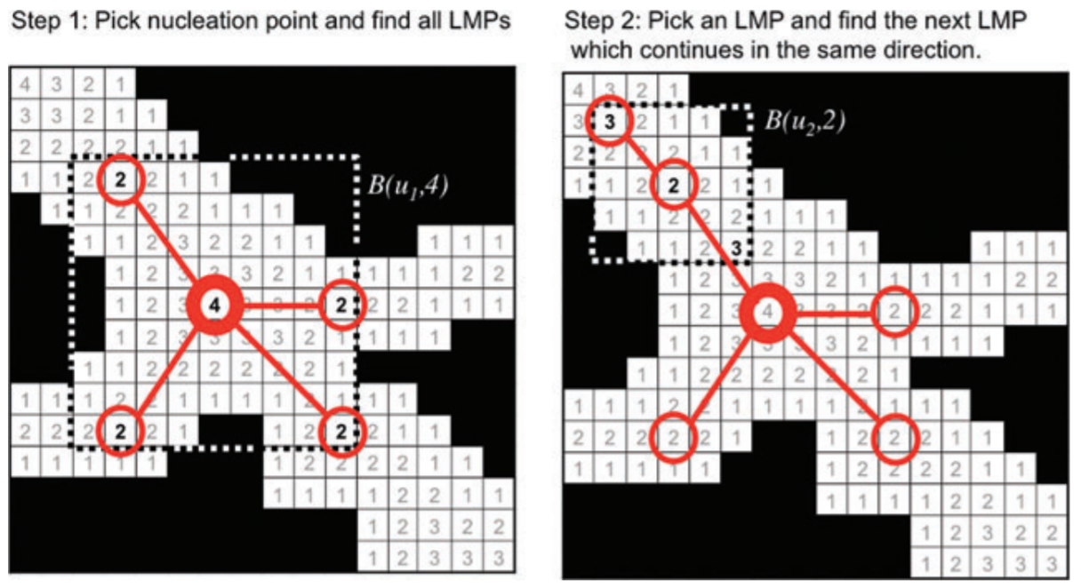
Nucleation and Local Maximum Points (LMPs)

Slide 9
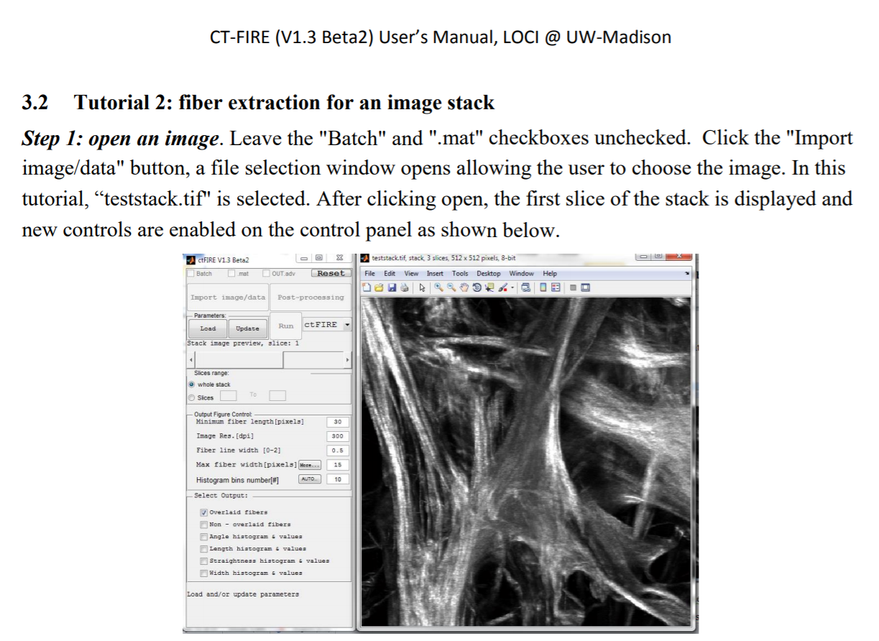
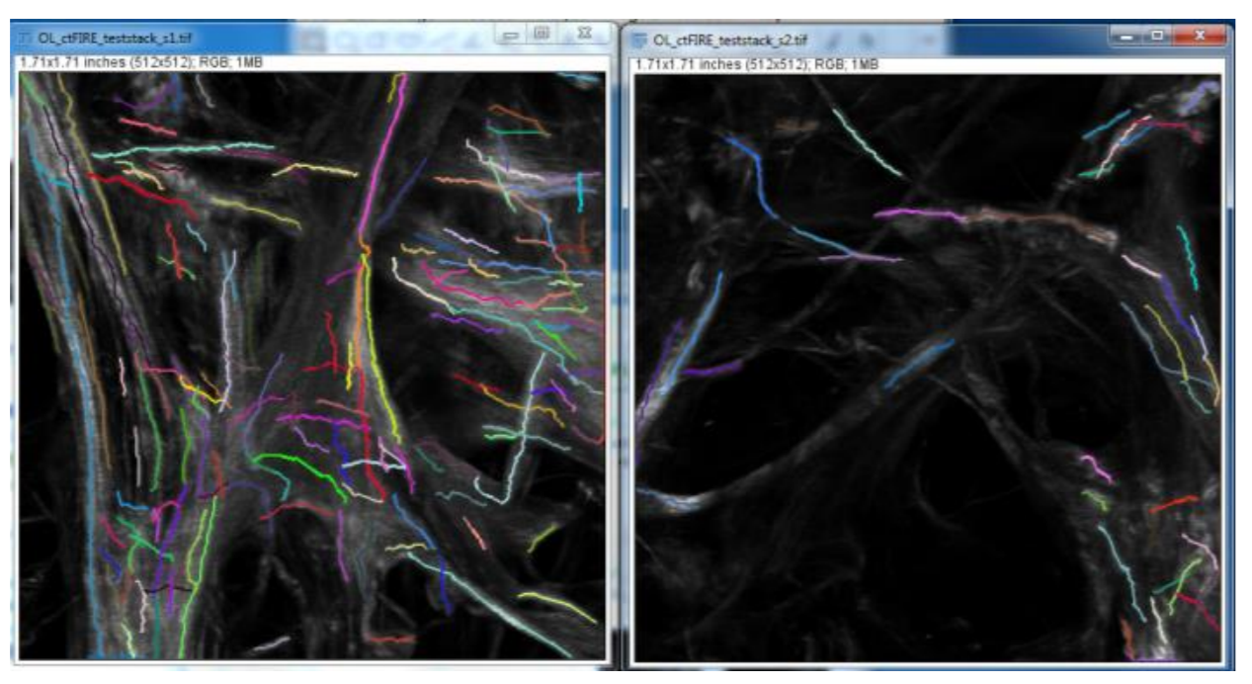
CT-FIRE’s standalone MATLAB application has the capability to process .tiff image stacks

Slide 10
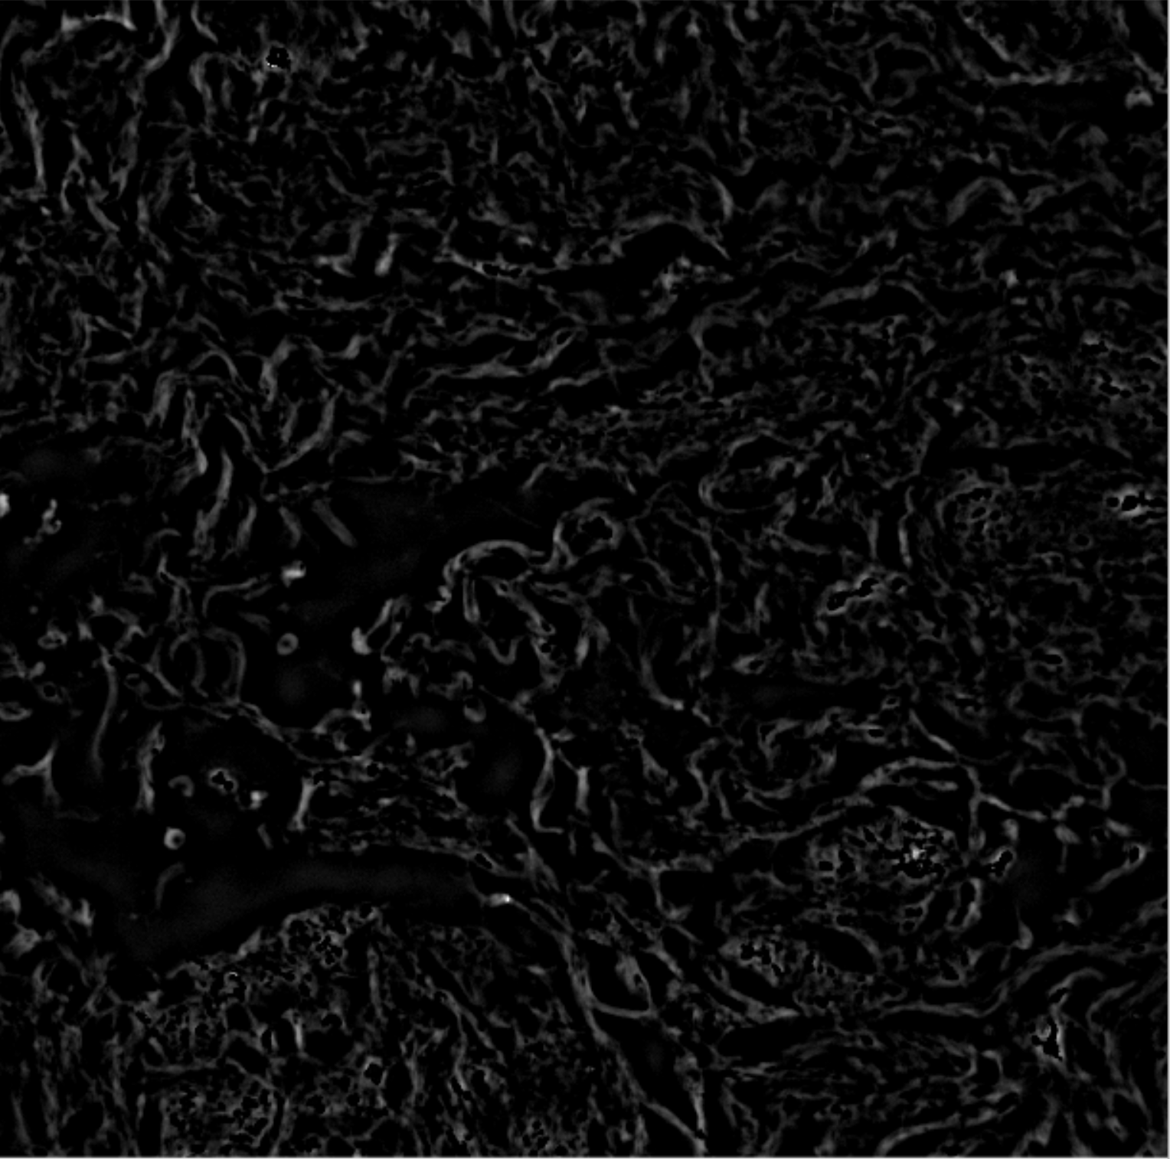

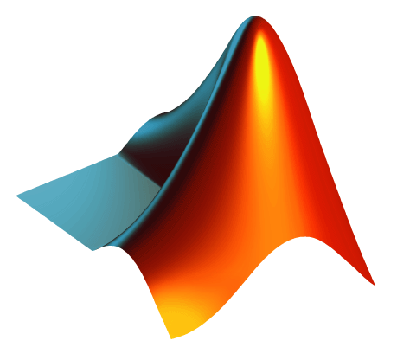
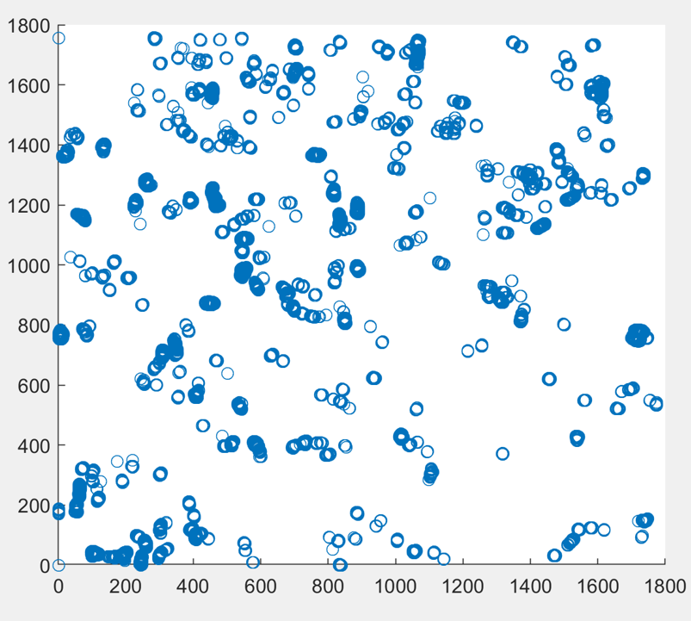
Technical Implementation
Zee-stack of images
3D Fire Algorithm
Return fibers to MATLAB for processing
Fiber visualization

Slide 11
Quivers and 2D Regression
Keshav Shivam

Slide 12
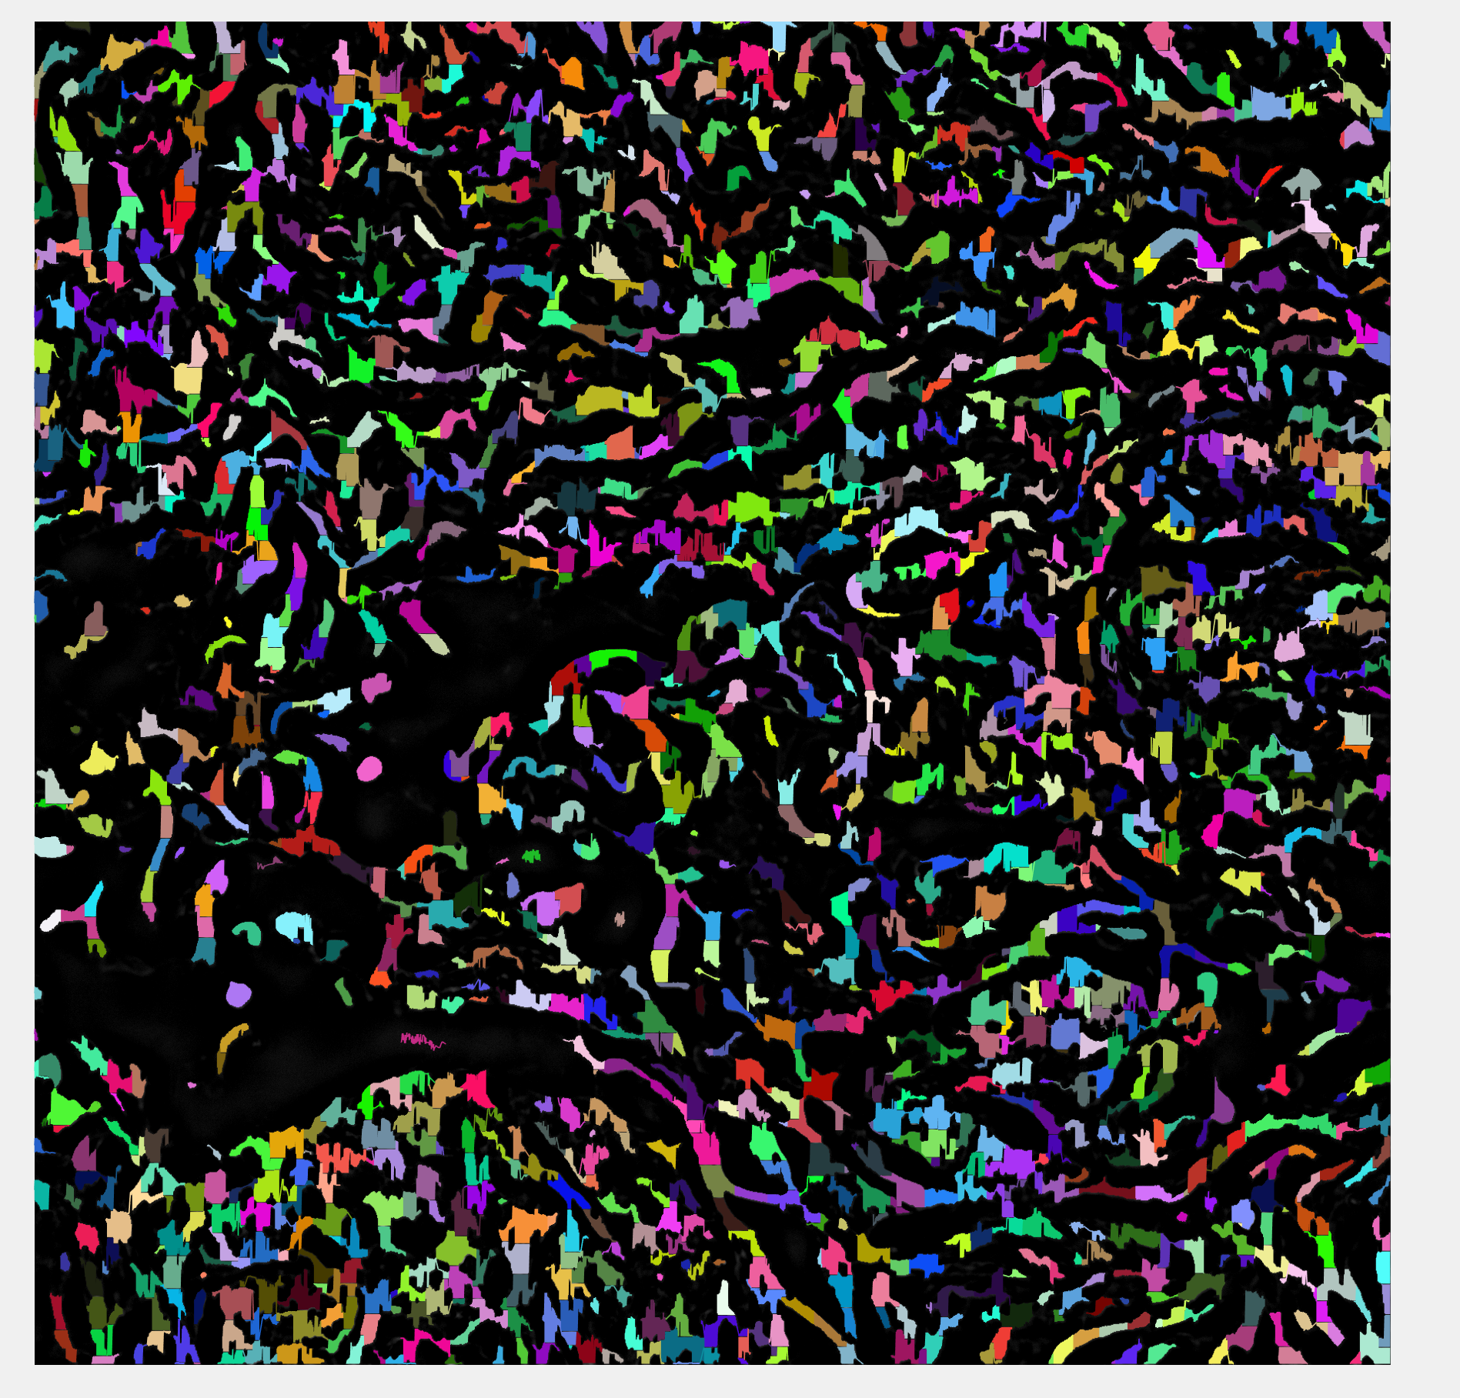
Ran in ~3 hrs, left it on overnight
fibers = FiberFinder(1, rows, cols, imgArray, 0.05, 10, 2, 13, 0);
32,000 nucleation points were expanded

Slide 13
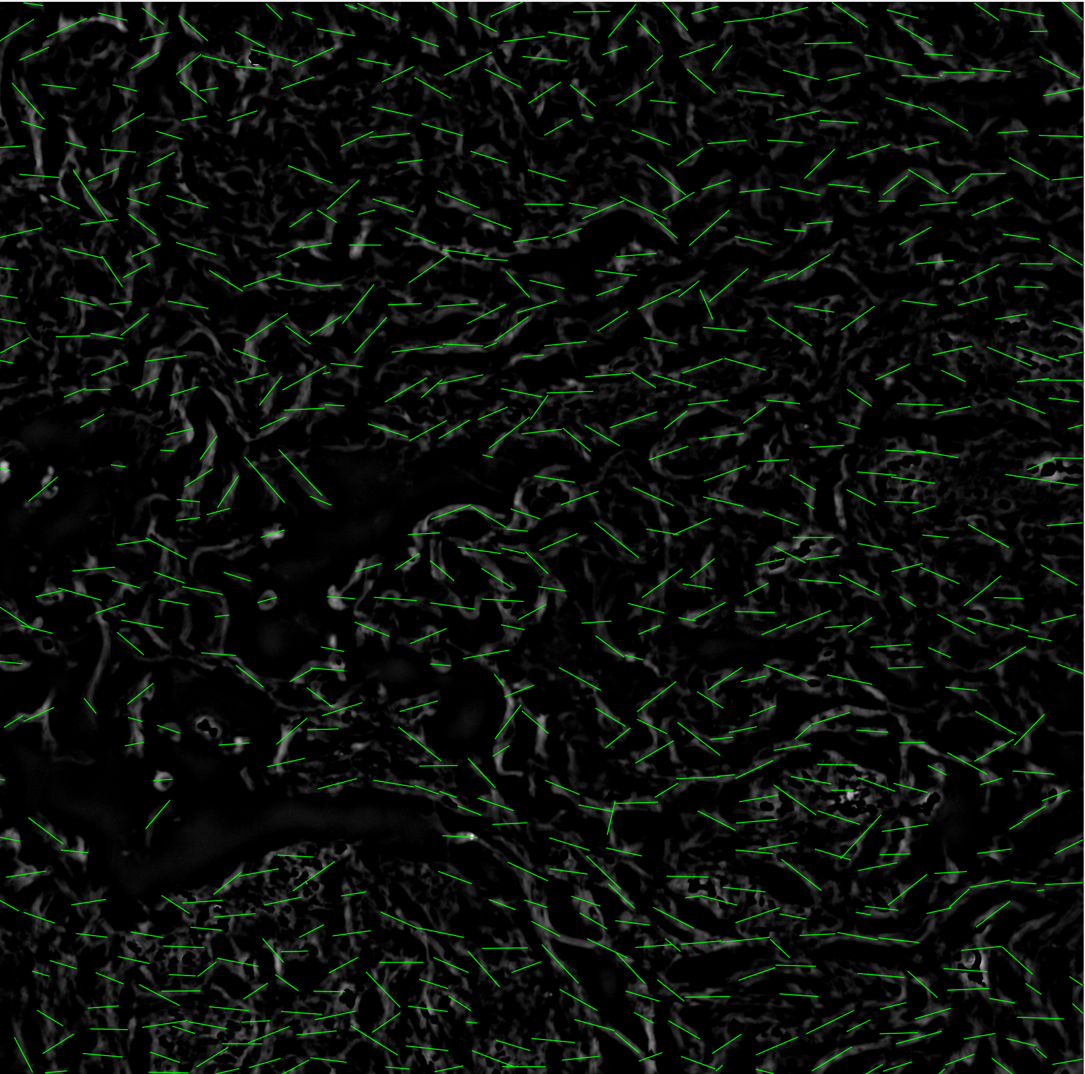
Performed linear regression to find line of best fit for each of the fibers
Ran in 30 min
fibers = FiberFinder(1, rows, cols, imgArray, 0.05, 10, 2, 13, 0);
50,000 nucleation points were expanded

Slide 14
Image preprocessing, testing for z = 1 … 5
Keshav Shivam

Slide 15
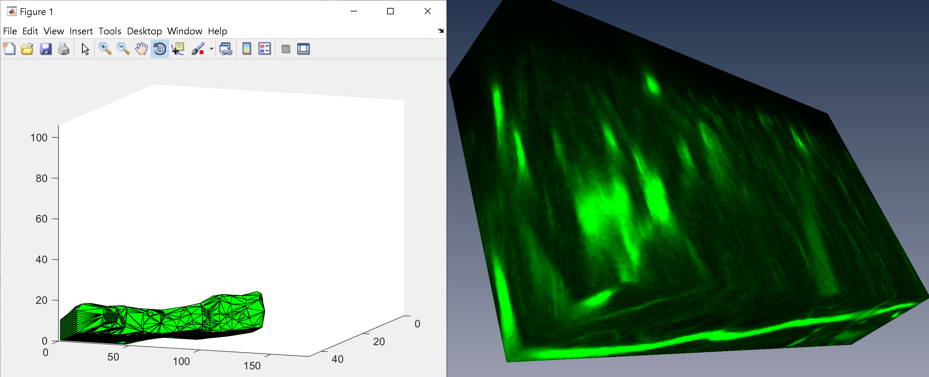
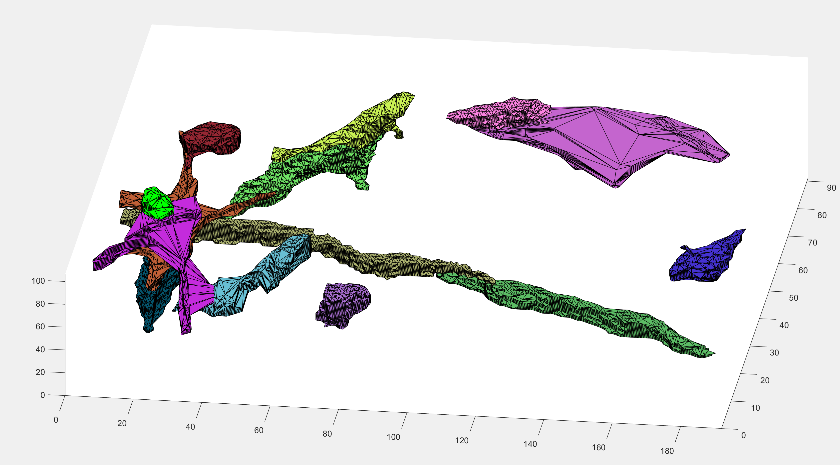
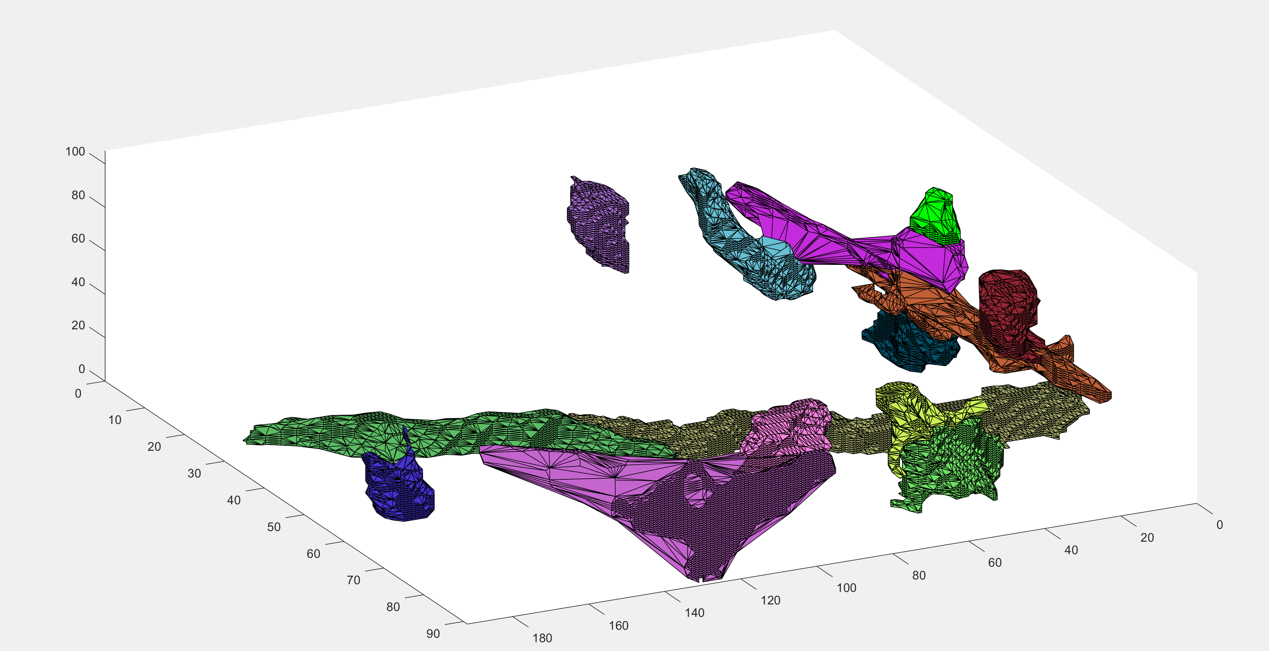
Results after mean subtract

Slide 16
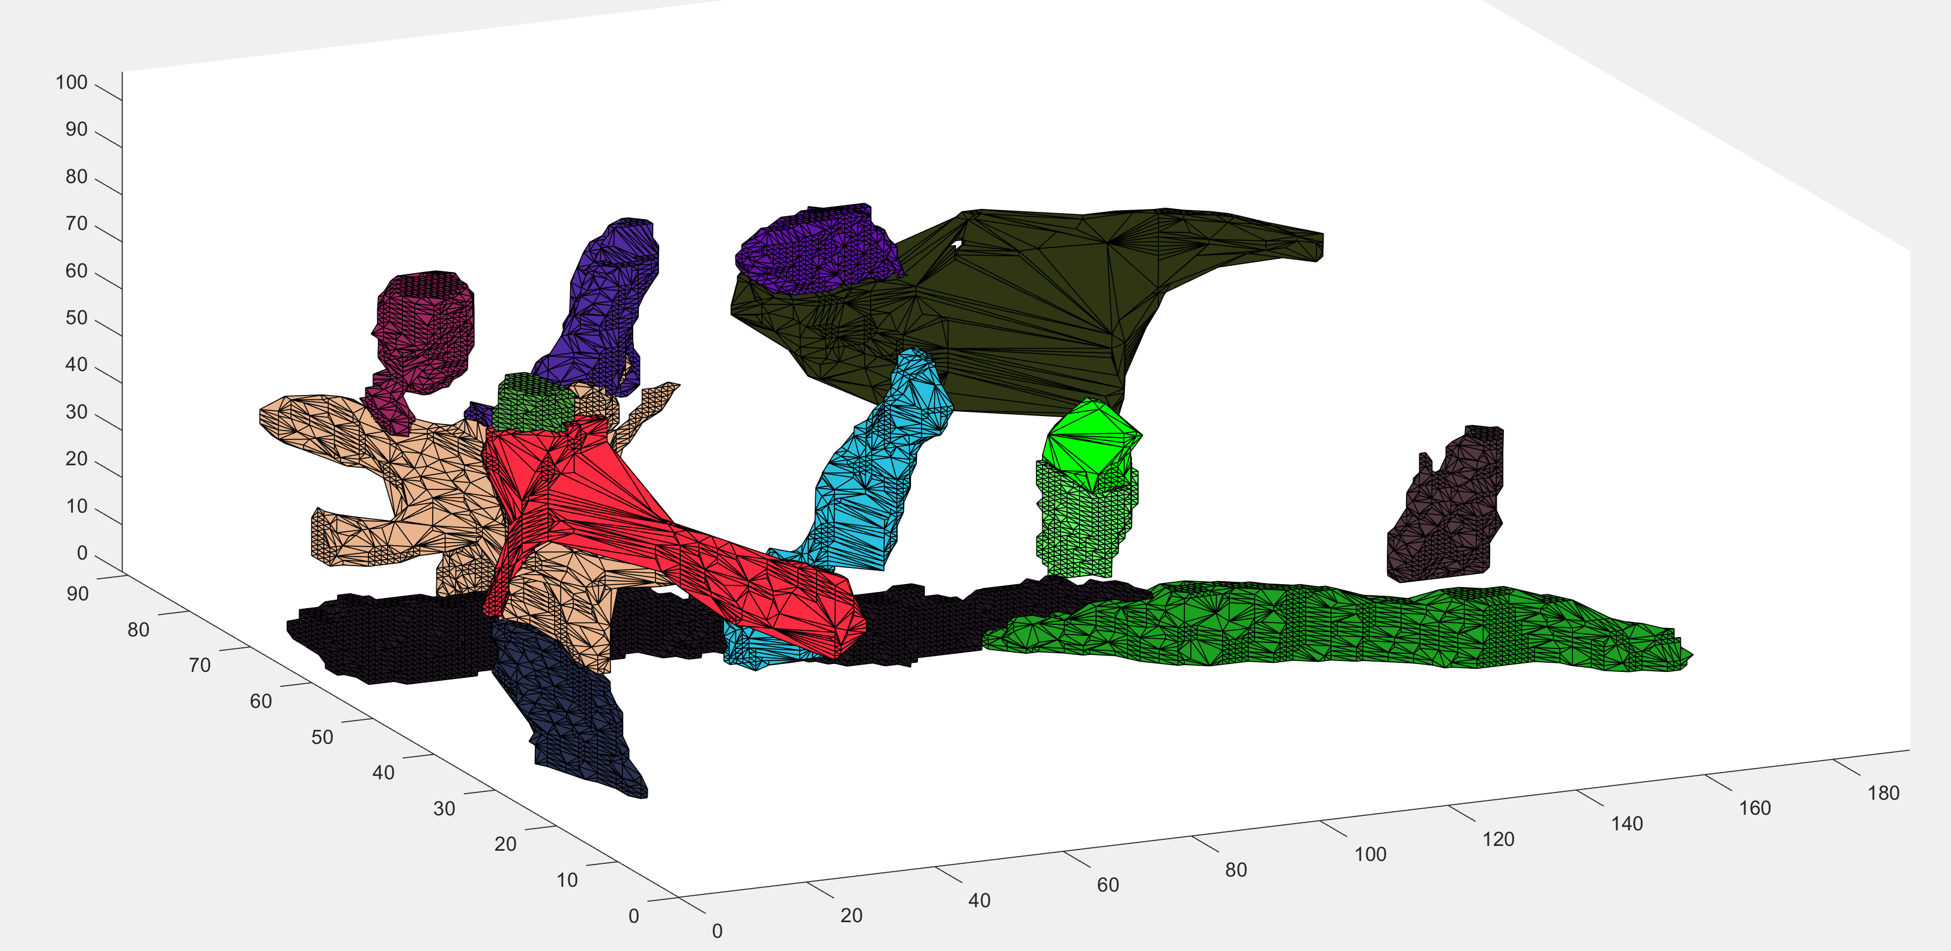
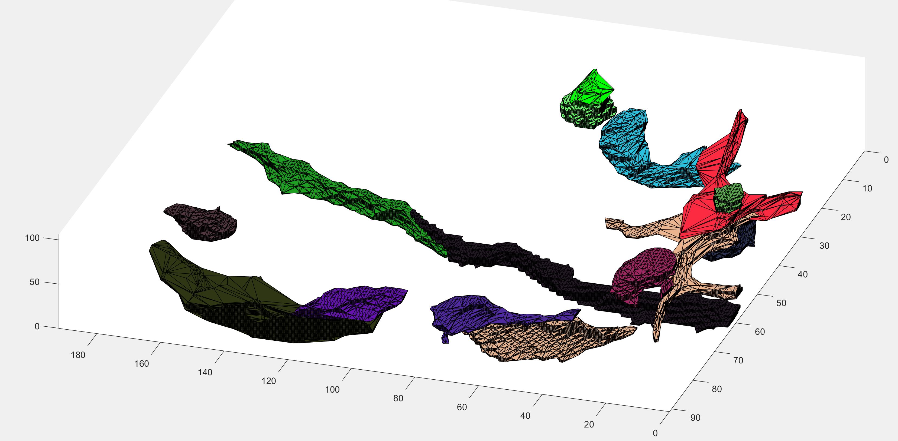
Results after mean subtract and bwareafilt()

Slide 17
Amira / Small FL tests

Slide 18
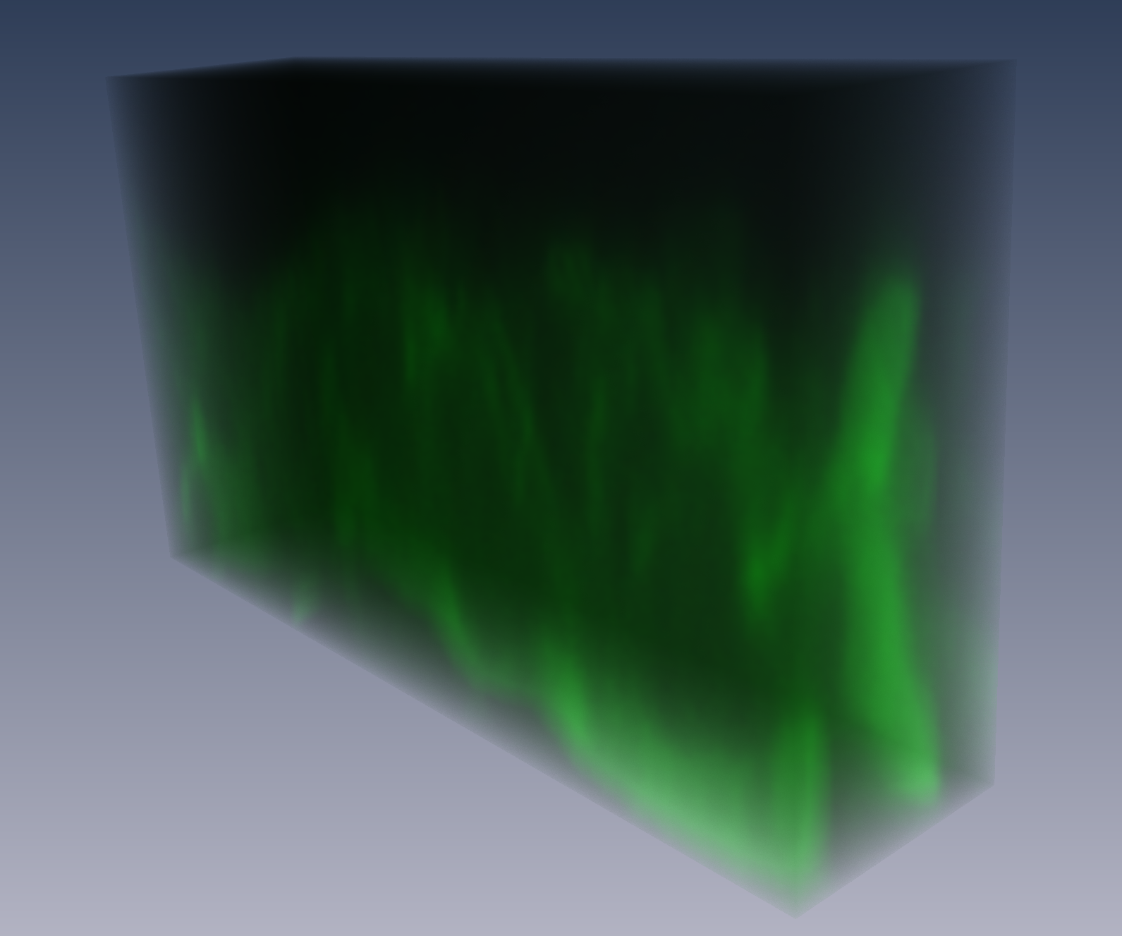
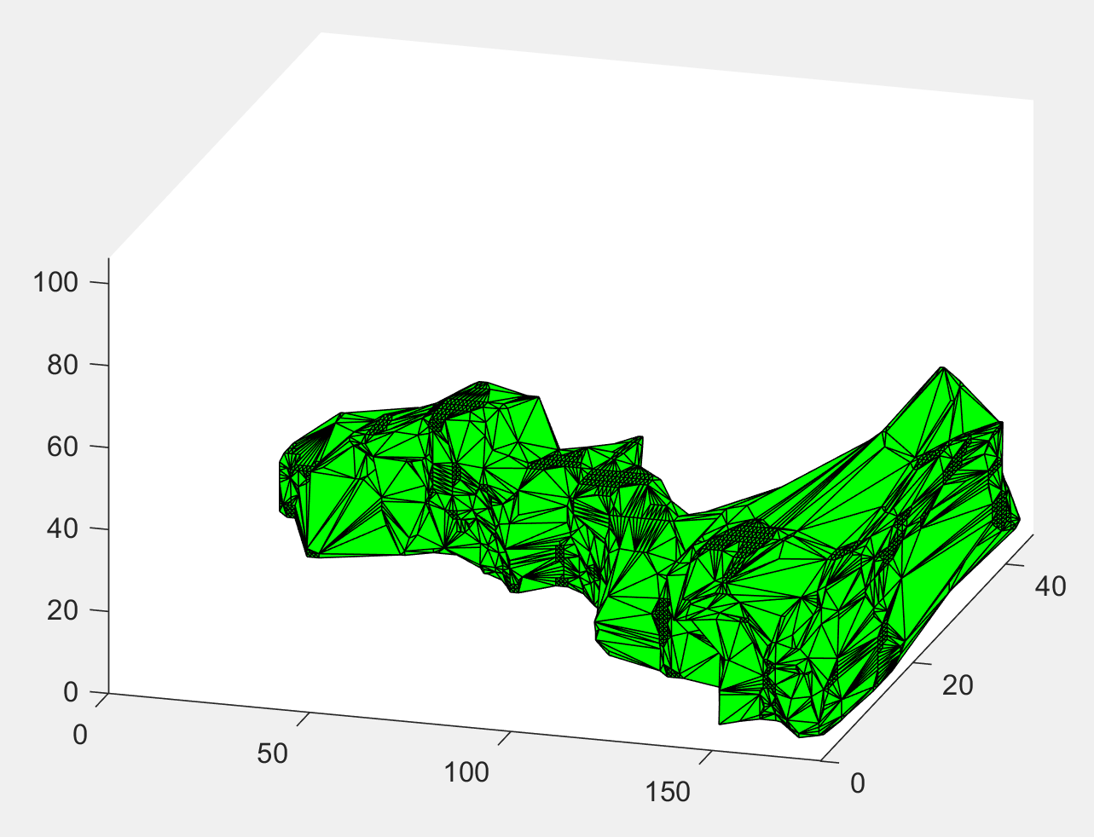
Straight fiber line
fibers = FiberFinder(depth, height, width, imgArray, 20, 10, 2, 1, 5)
Thresholding is very high
Changed max fiber length to be width, since its largest parameter. Average doesn’t work if there is a large difference in x, y, and z

Slide 19
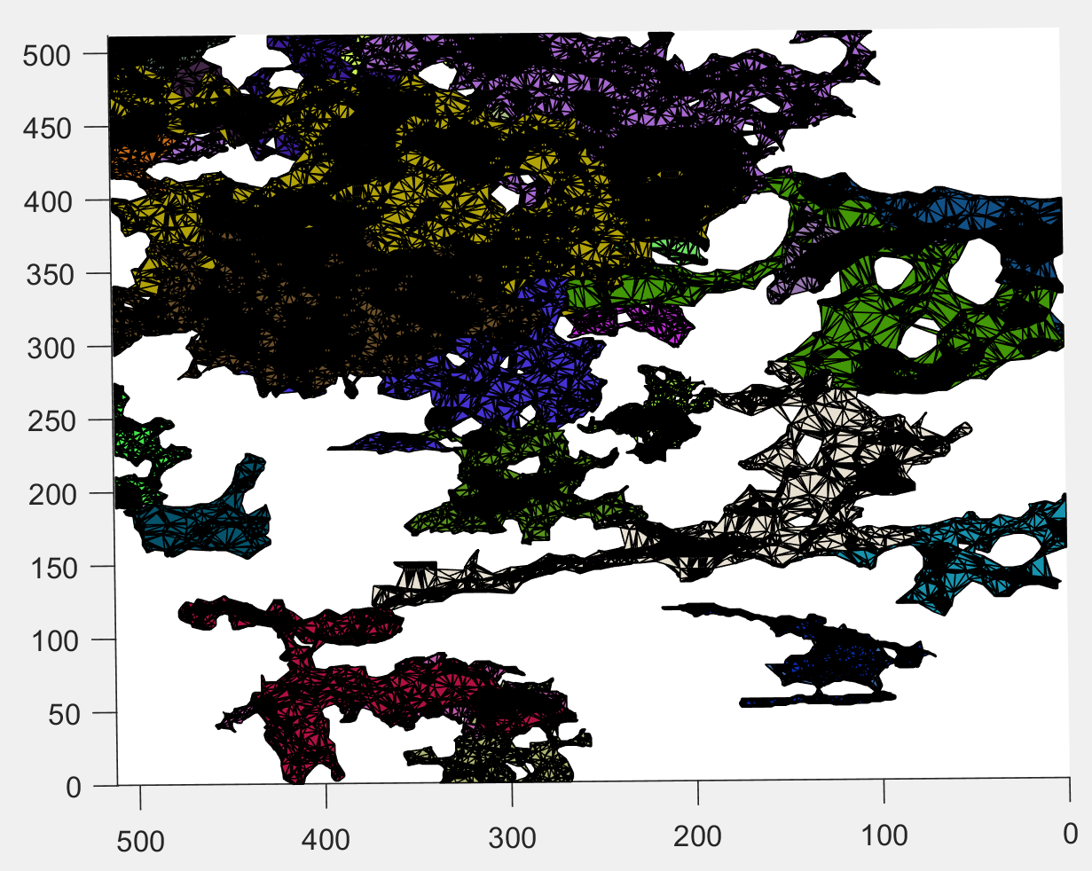
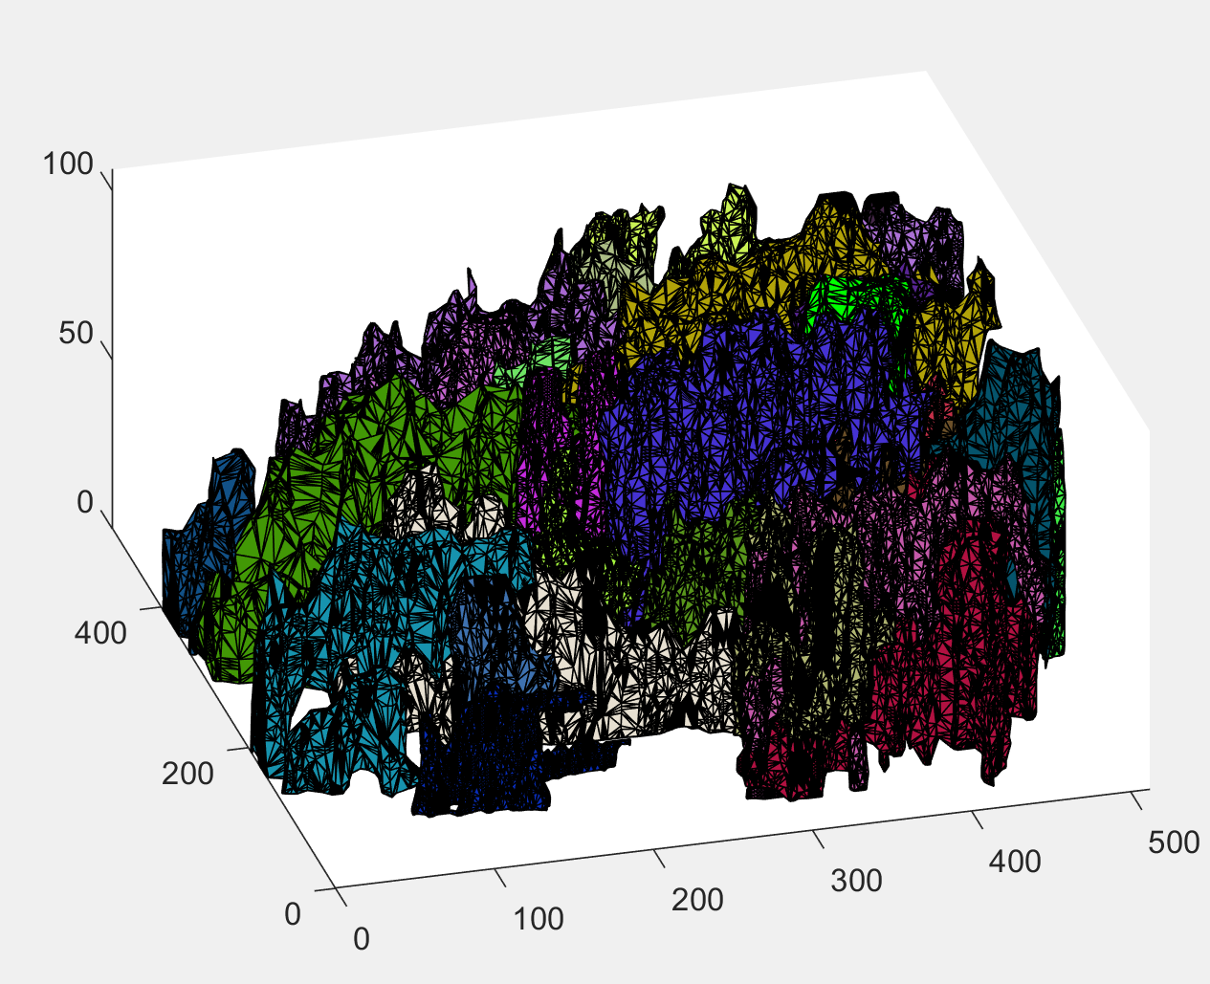
Original FL Zee stack
Fibers = FiberFinder(depth, height, width, imgArray, 20, 10, 2, 1, 5);
Found 66 fibers
Took 64 min
this->maxDFSDepth = this->maxFiberLength / lmpBoxRadius;

